Slide 1

Analyze E-commerce Sales Data using Pandas

Slide 2
Objective
To gain valuable insights into retail sales performance and identify key trends, patterns, and opportunities by utilizing Pandas for data analysis.

Slide 3
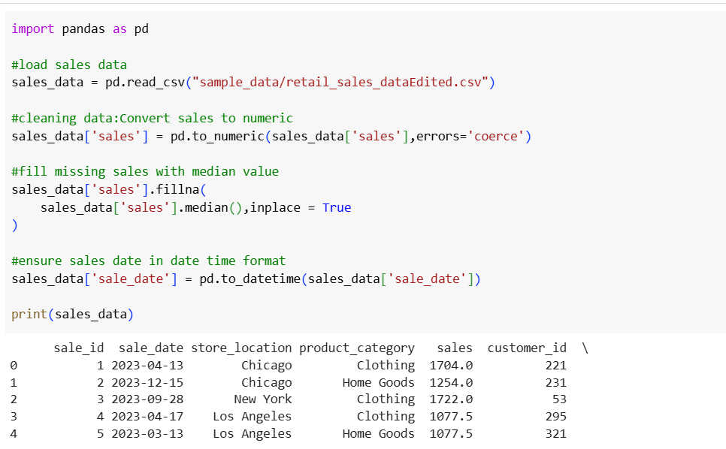
Data Cleaning and Preparation
Import and clean the retail sales dataset, handling missing values, inconsistencies, and outliers.
Convert data types as necessary (e.g., dates, numerical values).

Slide 4
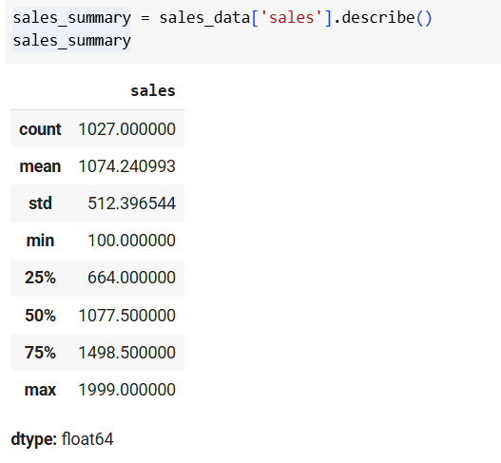
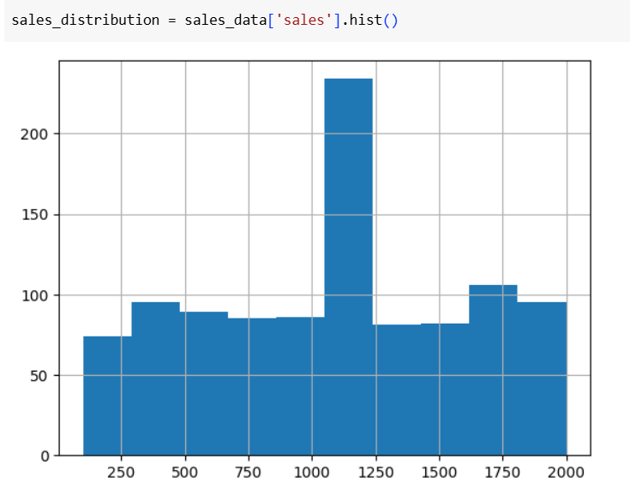
Exploratory Data Analysis (EDA):
Summarize sales and understand distribution using Histogram

Slide 5
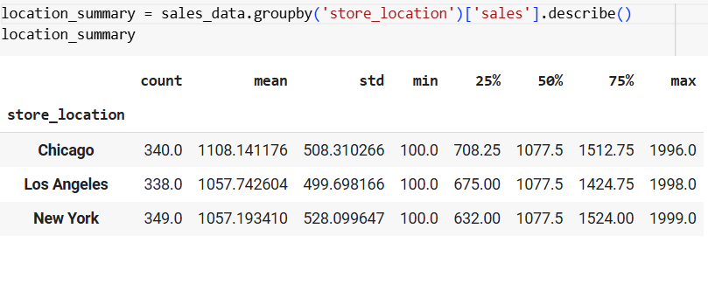
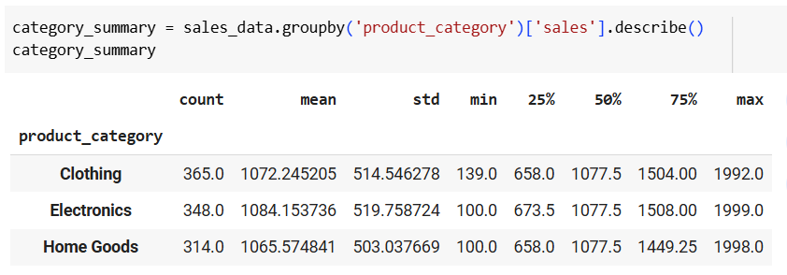
Summary by location and category

Slide 6
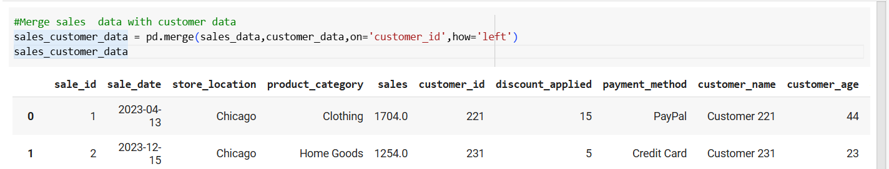

Merge Customer data , products data with Sales Data

Slide 7
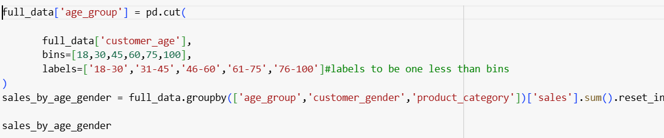
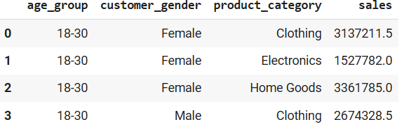
Use age bins to analyze retail sales data, to gain valuable insights into customer behavior

Slide 8
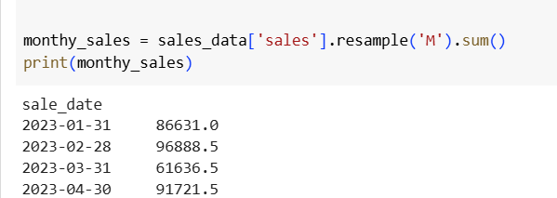
Analyze Monthly Sales

Slide 9
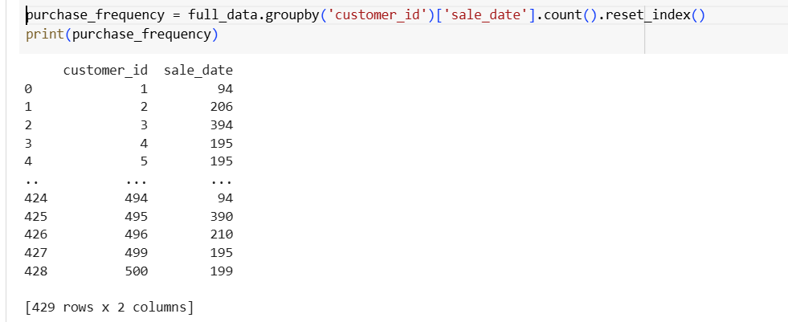
Analyze purchase frequency of customer

Slide 10
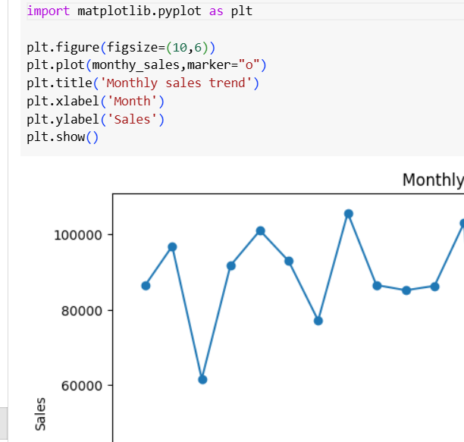
Data Visualization –Monthly trends

Slide 11

Thank you

